Slide 1
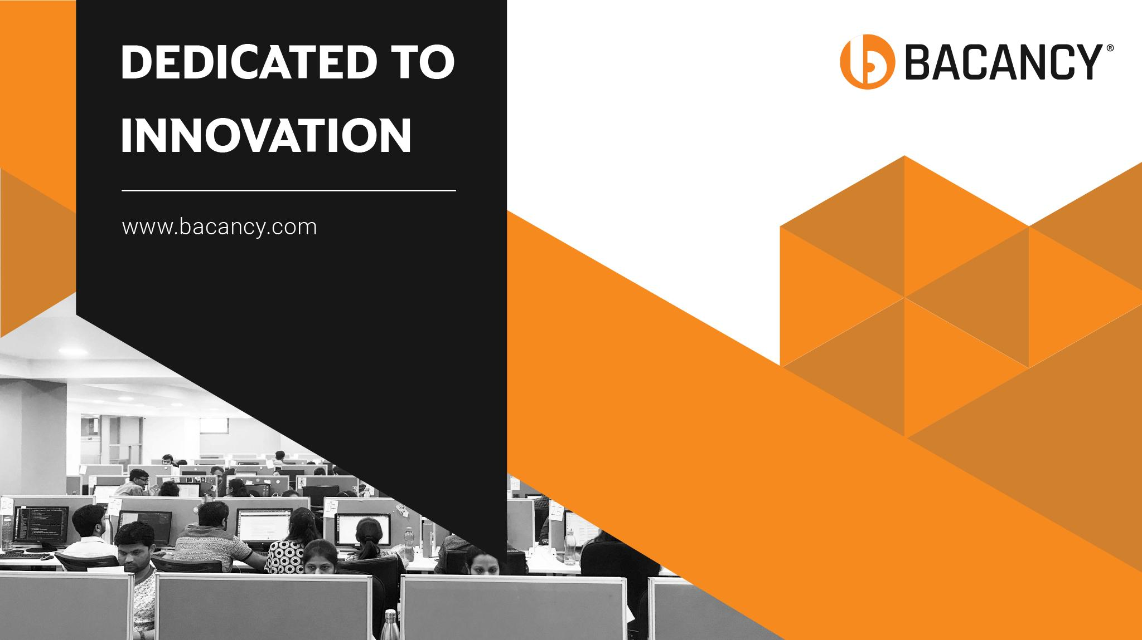

Slide 2

Customer Satisfaction
Is Our Highest Priority

Slide 3
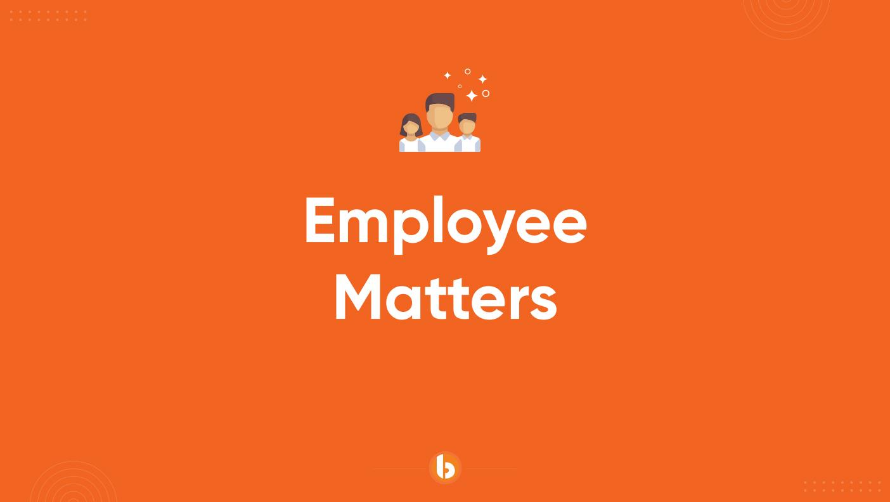

Slide 4
In this session
Achieved
What we are learning in this session
Asynchronous Programming
Multithreading and Parallel Programming
www.bacancytechnology.com

Slide 5
Let’s Start

Slide 6
Asynchronous Programming
Achieved
Asynchronous Programming
async and await keywords
Task-based asynchronous programming
Parallel processing with Task and Task.Run
Multithreading and Parallel Programming
Using Thread, Task, and Parallel classes
Synchronization mechanisms
Concurrent collections
Key Features:Non-blocking I/O operations
Efficient resource utilization
www.bacancytechnology.com

Slide 7
Asynchronous Programming
Achieved
async: Marks a method as asynchronous, enabling the use of await.
await: Suspends the method execution until the awaited task is complete.
Example
public async Task FetchDataAsync()
{
var data = await GetDataFromAPI();
Console.WriteLine(data);
}
www.bacancytechnology.com

Slide 8
Asynchronous Programming
Achieved
Task Class: Represents an asynchronous operation.
Advantages
Simplified handling of asynchronous code.
Supports cancellation and continuations.
Example
Task<int> task = Task.Run(() => ComputeSum());
int result = await task;
www.bacancytechnology.com

Slide 9
Multithreading and Parallel Programming
Achieved
Definition
Running multiple threads in parallel within the same process.
Key Objectives
Utilize multiple CPU cores.
Improve performance for computationally intensive operations.
Example
Thread t = new Thread(() => Console.WriteLine("Thread Example"));
t.Start();
www.bacancytechnology.com

Slide 10
Multithreading and Parallel Programming
Achieved
Synchronization Mechanisms
Used to avoid data corruption in shared resources.
Mechanisms in C#
lock: Simplest way to synchronize access.
Monitor: Fine-grained control.
Mutex: Inter-process synchronization.
Semaphore: Controls access to a resource pool.
lock(obj)
{
sharedResource++;
}
www.bacancytechnology.com

Slide 11
Thank you

